Slide 1
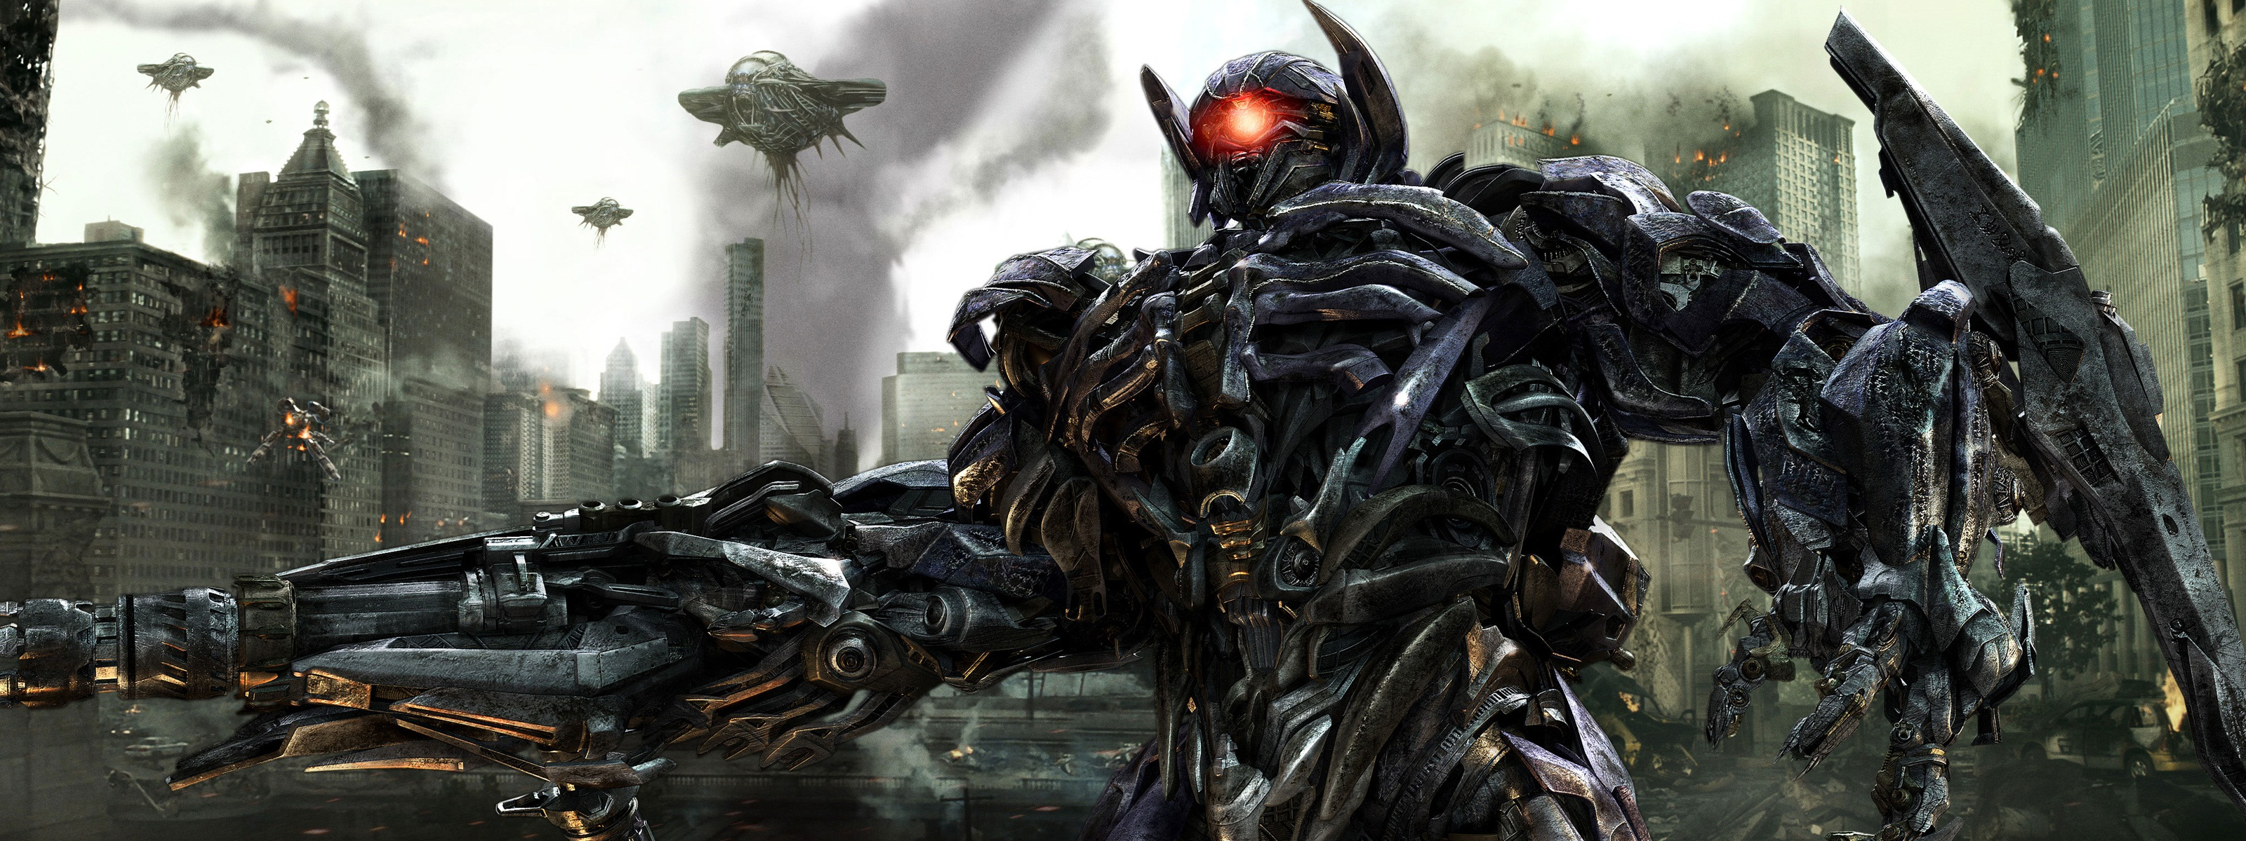

Adventure Games Devoloping
Making by : A.vignesh sethupathi
From : sivagangai (d.t)

Slide 2

Heading : ocean of games
used in Animation :
Text shadow ,then
Two colors used in heading tag
Output :
blinking

Slide 3
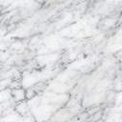
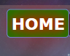
Navigation bar
On mouse over in change to color and background grow and blink
Animation,
Hover,
Border,
Border radius,
Duration time
Used by,
Output :

Slide 4
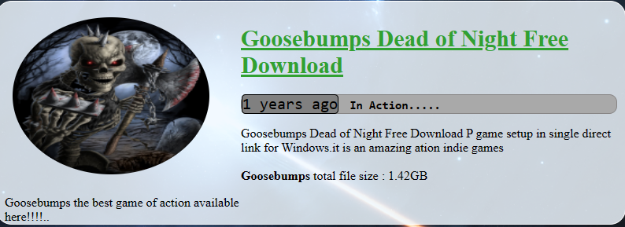
Game 1
Game name
&
Game detail’s
Output :

Slide 5
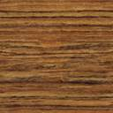
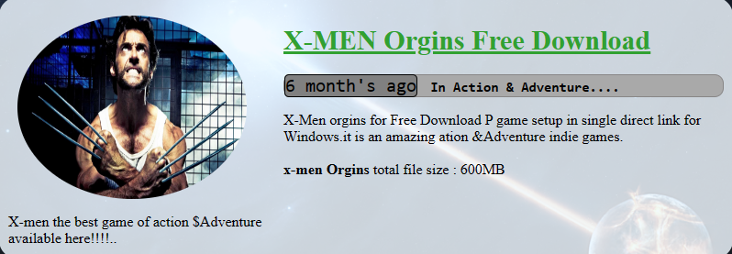
Game 2
Game name
&
Game detail’s
Output :

Slide 6
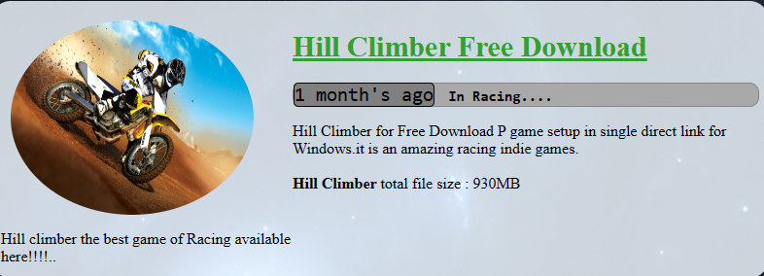
Game 3
Game name
&
Game detail’s
Output :

Slide 7

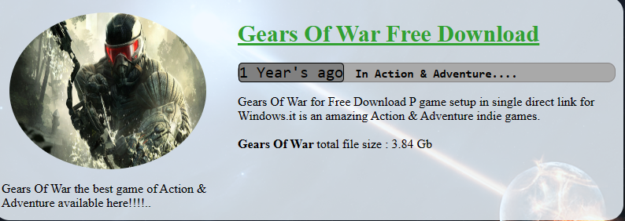
Game 4
Game name
&
Game detail’s
Output :

Slide 8

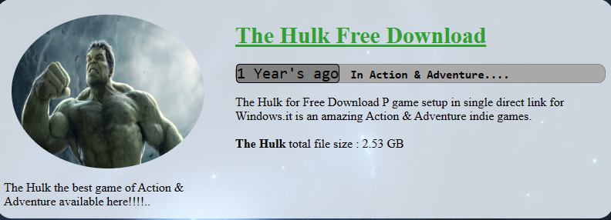
Game 5
Game name
&
Game detail’s
Output :

Slide 9
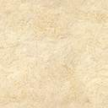
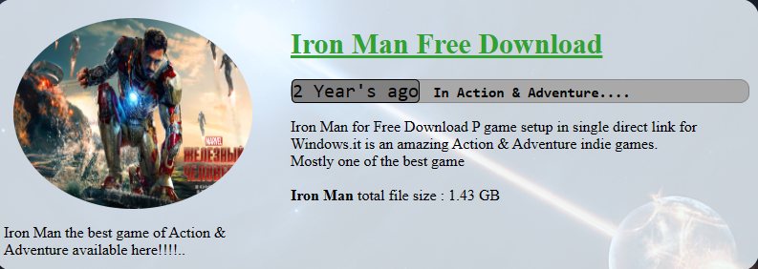
Game 6
Game name
&
Game detail’s
Output :

Slide 10
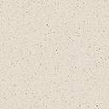
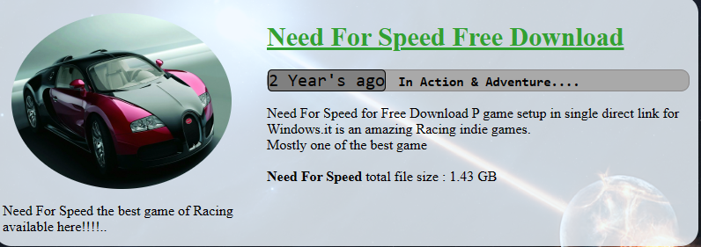
Game 7
Game name
&
Game detail’s
Output :

Slide 11

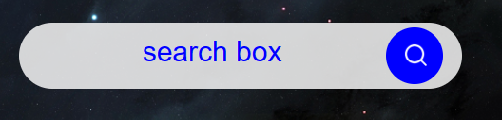
Search box
Button create then inside A search image to absolute in website , then
Used to placeholder for(search box),
Input box in radius to use 50%
A Input box create in website
Output :

Slide 12

Adverticement
Using by
Animation to using six picture’s.
Flex using picture box.
Animation duration and @keyframes used to slide showing.
Output :

Slide 13
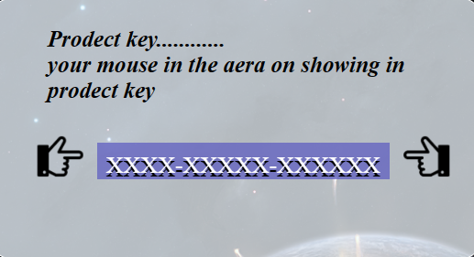
Games product key
Output :

Slide 14

Gamesproduct key
On mouse over in xxxxxx mark under this product key is showing
Output :

Slide 15
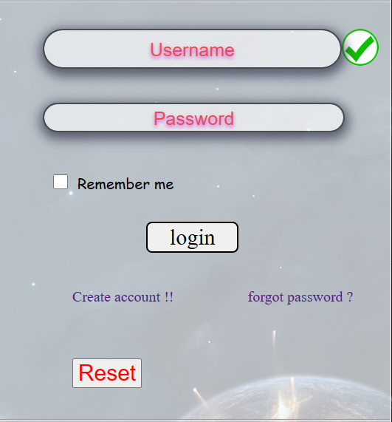
Login form
Output :
Username and password to create to required.
User name fill
&
password fill
Then,
checkbox click to login
To successfully.
Reset button used to any typing in input box for reseted

Slide 16
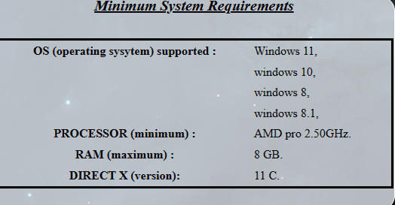
System supported details
Output :

Slide 17

footer
Footer details for website links and maps and privacy
Output :

Slide 18
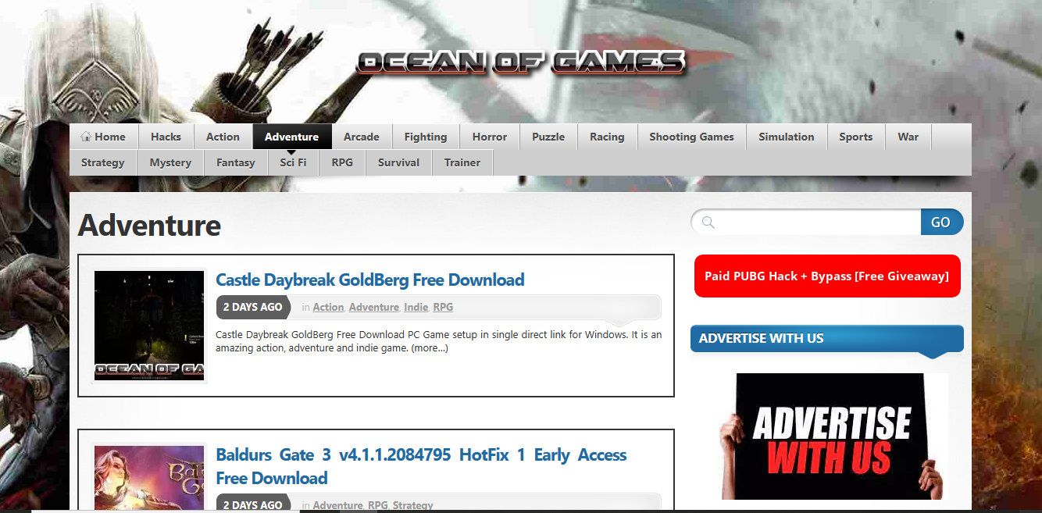
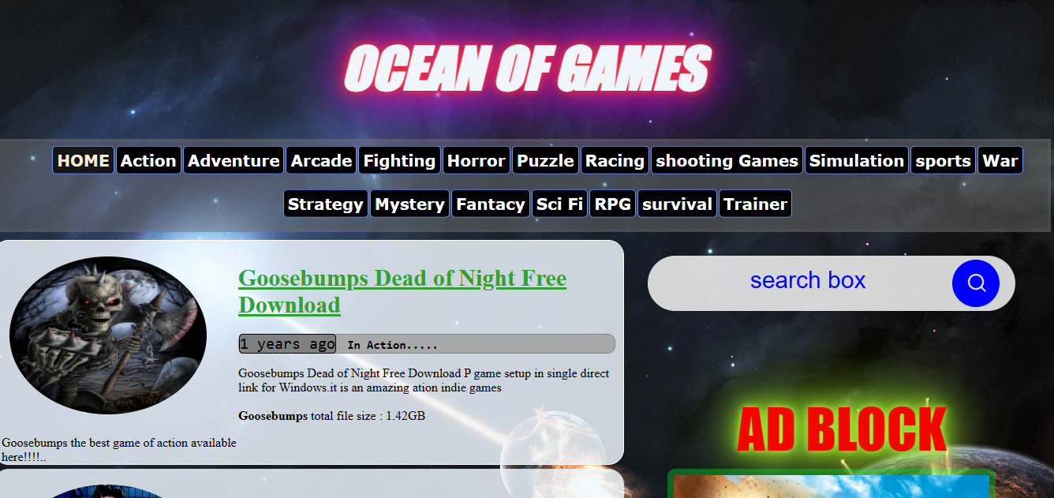
Model website
Original website
My website

Slide 19
Thanks for watching

